Slide 1









Slide 2




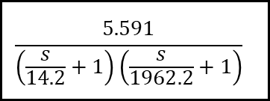


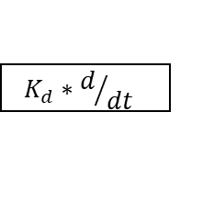


$$K_{P}$$
SP
err
+
CO
$$\frac{5.591}{\left(\frac{s}{14.2}+1\right)\left(\frac{s}{1962.2}+1\right)}$$
y
+
$$K_{I}∗\int{dt}$$
-
+
FB
$$K_{d}∗d/{dt}$$

Slide 3




$$K_{P}$$
SP
err
+
CO
$$\frac{5.591}{\left(\frac{s}{14.2}+1\right)\left(\frac{s}{1962.2}+1\right)}$$
y
+
$$K_{I}∗\int{dt}$$
-
+
FB
$$K_{d}∗d/{dt}$$

Slide 4


$$K_{P}$$
SP
err
+
CO
$$\frac{5.591}{\left(\frac{s}{14.2}+1\right)\left(\frac{s}{1962.2}+1\right)}$$
y
+
$$K_{I}∗\int{dt}$$
-
+
FB
$$K_{d}∗d/{dt}$$

Slide 5





